Slide 1
Untangling The Reformation
Untangling the Reformation: History of the Catholic Church
THEME: OBEDIENT FAITH
Early 16th century
Rom 1:5 Through him we received grace and apostleship to call all the Gentiles to the obedience that comes from faith for his name's sake.

Slide 3
Hos 4:6 My people are destroyed from lack of
knowledge. "Because you have rejected knowledge, I also reject you as my priests; because you have ignored the law of your God, I also will ignore your children.”

Slide 4
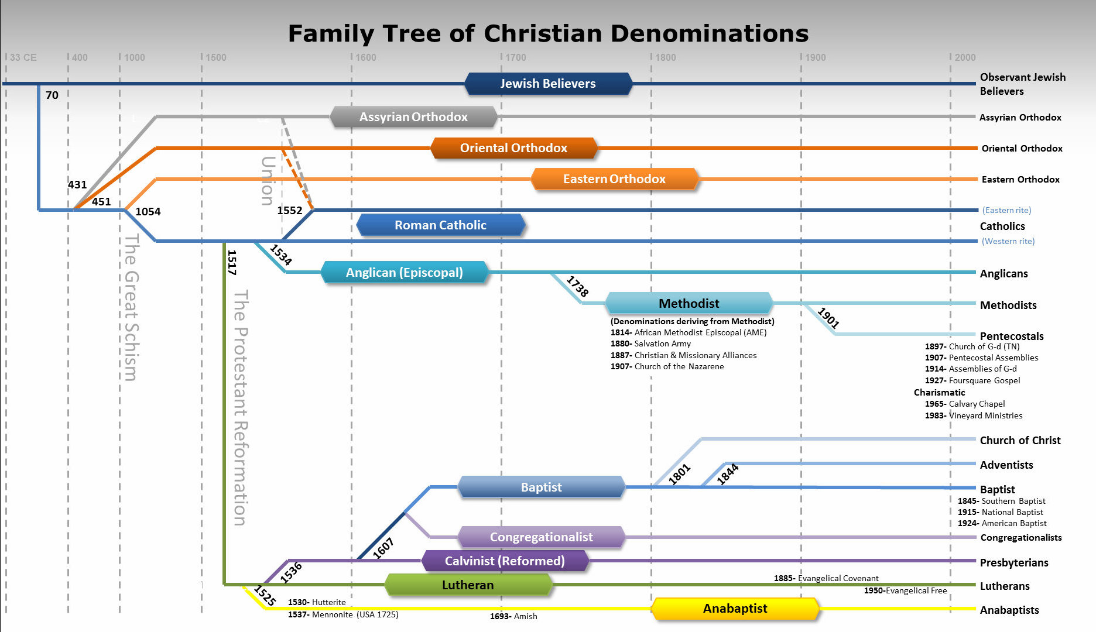
Our focus

Slide 5
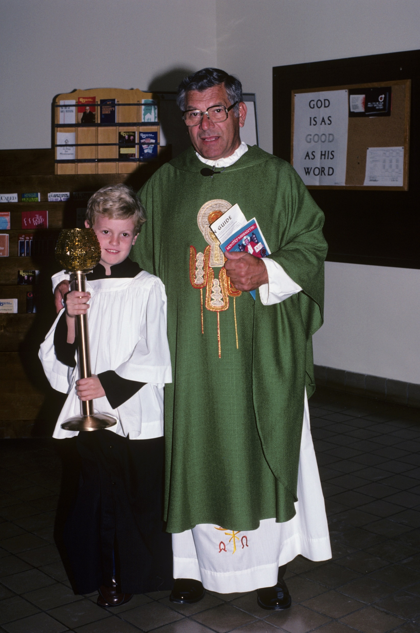
How tangled up are you?
Untangling the Reformation: History of the Catholic Church
Sacraments:
Baptism
First Communion (Eucharist)
Confirmation
Confession (Penance & Reconciliation)
Early 16th century

Slide 6
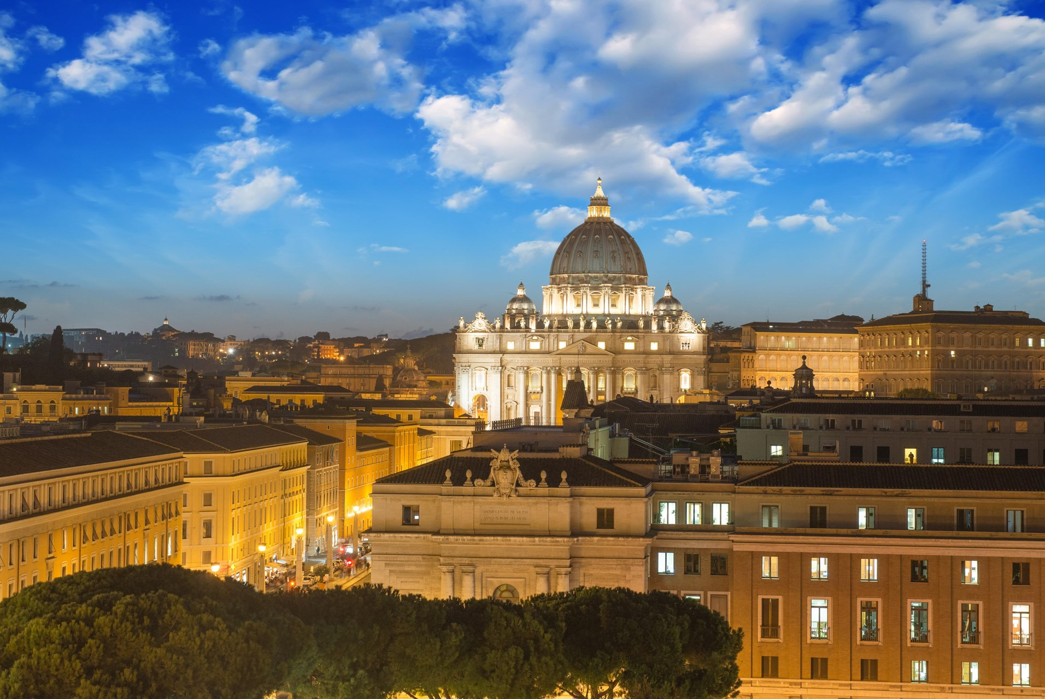


The History of the Catholic Church

Slide 7
The History of the Catholic Church
CATHOLIC
  Greek: καθολικός
  romanized: katholikos
  lit. 'universal’
  First used to describe the church in the early 2nd century in a letter written by Saint Ignatius of Antioch to the Smyrnaeans ~ 110 AD.
  Of note, Ignatius of Antioch is also attributed to the earliest recorded use of “Christianity” (as expanded onto “Christian” in the Bible) ~ 100AD.
  2 Peter is believed to be the newest of the books of the NT ~ 110 AD.

Slide 8
The History of the Catholic Church
The Church of Rome
Doctrine: Sacred Scripture + Sacred Tradition
Sacred Tradition and Sacred Scripture form one sacred deposit of the word of God, committed to the Church. Holding fast to this deposit the entire holy people united with their shepherds remain always steadfast in the teaching of the Apostles, in the common life, in the breaking of the bread and in prayers (see Acts 2, 42, Greek text), so that holding to, practicing and professing the heritage of the faith, it becomes on the part of the bishops and faithful a single common effort.
But the task of authentically interpreting the word of God, whether written or handed on, has been entrusted exclusively to the living teaching office of the Church, whose authority is exercised in the name of Jesus. This teaching office is not above the word of God, but serves it, teaching only what has been handed on, listening to it devoutly, guarding it scrupulously and explaining it faithfully in accord with a divine commission and with the help of the Holy Spirit, it draws from this one deposit of faith everything which it presents for belief as divinely revealed.
It is clear, therefore, that Sacred Tradition, Sacred Scripture and the teaching authority of the Church, in accord with God's most wise design, are so linked and joined together that one cannot stand without the others, and that all together and each in its own way under the action of the one Holy Spirit contribute effectively to the salvation of souls. - Dei verbum, the Second Vatican Council's Dogmatic Constitution on Divine Revelation, 1965

Slide 9
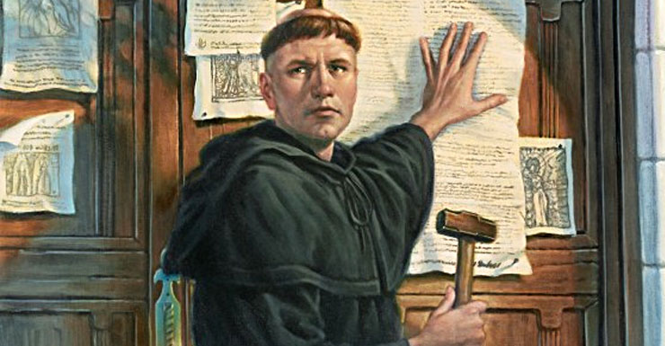
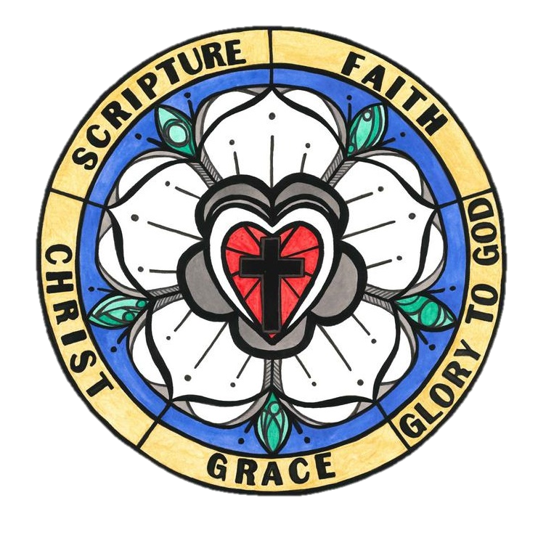
  Sola Scriptura–Scripture Alone
  Sola Gratia–Grace Alone
  Sola Fide–Faith Alone
  Solus Christus–Christ Alone
  Soli Deo Gloria–God’s Glory Alone

Slide 10
Untangling The Reformation
Untangling the Reformation: History of the Catholic Church
Early 16th century
Total depravity Man is incapable of playing any role in his salvation
Unconditional election Nothing man does influence’s God’s election
Limited Atonement The sacrifice of Jesus was only for the elect
Irresistible Grace It is impossible to reject God’s grace
Preservation of the saints The elect cannot fall away

Slide 11
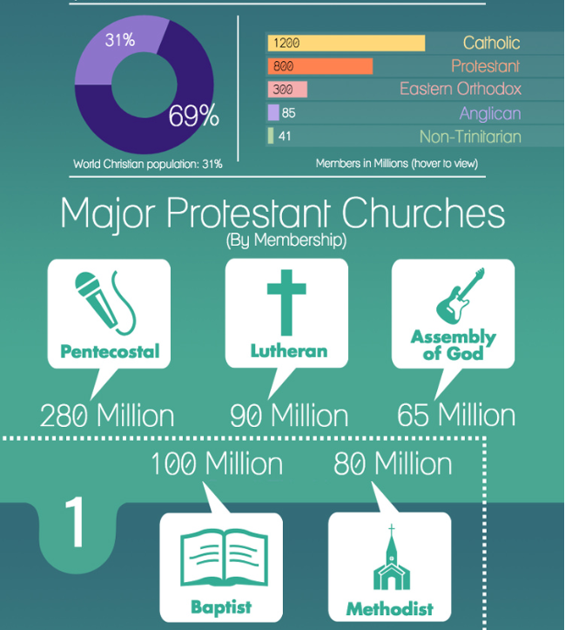
Untangling The Reformation
Why Does All of This Matter?
Where Did You Fall Into This?

Slide 12
Untangling The Reformation
Unconditional Election
(Predestination)
“By the decree of God, for the manifestation of His glory, some men and angels are predestinated unto everlasting life, and other foreordained to everlasting death” (Article III).

Slide 13
Untangling The Reformation
Unconditional Election
(Predestination)
Ephesians 1:4-5
“For he chose us in Him before the creation of the world to be holy and blameless in his sight. In love he predestined us for adoption to sonship through Jesus Christ, in accordance with his pleasure and will…”

Slide 14
Untangling The Reformation
Unconditional Election
(Predestination)
^{4 ”}For he chose us (who is this “us”?) in Him (it is those who would be IN HIM) before the creation of the world to be holy and blameless in his sight. In love (so the same chosen before the creation of the world are the same Christians who would walk IN HIM in HOLINESS WITHOUT BLAME IN LOVE)
⁵ he predestinated us for (for what?) the adoption to sonship (HOW?) THROUGH JESUS CHRIST (same concept: we are adopted as children if we live BY Jesus Christ) in accordance with his pleasure and will…”
-Eternalcall.com

Slide 15
Untangling The Reformation
Unconditional Election
(Predestination)
God predestined the class of people (not individuals) would follow the PREDESTINED WAY to salvation by saving those who:
would believe in His Son Jesus for the forgiveness of sins
would be IN HIM
would live in Holiness and without blame
would be IN LOVE (God IS love)

Slide 16
Untangling The Reformation
Unconditional Election
(Predestination)
Which class of persons? It is those who willingly submit to the foreknown God’s plan of salvation and redemption, which involves believing and obeying Jesus Christ (Hebrews 5:8-9), and entering into that fellowship that is described as being “IN HIM”

Slide 17
Untangling The Reformation
Preservation of the saints
“Once Saved, Always Saved”
John 10:27-28
“My sheep listen to my voice; I know them and they follow me. I give them eternal life, and they shall never perish; no one will snatch them out of my hand.”

Slide 18
Untangling The Reformation
Preservation of the saints
“Once Saved, Always Saved”
Read the full chapter of John 10…remember context!
The focus here was really Jesus being the Messiah.
John 10:7-9
“Therefore Jesus said again, “Very truly I tell you, I am the gate for the sheep. All who have come before me are thieves and robbers, but the sheep have not listened to them. I am the gate; whoever enters through me will be saved.”

Slide 19
Untangling The Reformation
Preservation of the saints
“Once Saved, Always Saved”
Once Saved – Salvation isn’t a one time act!
1 Corinthians 1:18
“For the message of the cross is foolishness to those who are perishing, but to us who are being saved it is the power of God.” (Notice present participle)

Slide 20
Untangling The Reformation
Preservation of the saints
“Once Saved, Always Saved”
Once Saved – Salvation isn’t a one time act!
Jude 3
“Dear friends, although I was very eager to write to you about the salvation we share, I felt compelled to write and urge you to contend for the faith that was once for all entrusted to God’s holy people.” (Notice action to contend for the faith)
Jude 5
“Though you already know all this, I want to remind you that the Lord at one time delivered his people out of Egypt, but later destroyed those who did not believe.”

Slide 21
Untangling The Reformation
Preservation of the saints
“Once Saved, Always Saved”
Once Saved – Salvation isn’t a one time act!
Philippians 2:12
“Therefore, my dear friends, as you have always obeyed – not only in my presence, but now much more in my absence – continue to work out your salvation with fear and trembling.” (Notice tense again in work out your salvation)

Slide 22
Untangling The Reformation
Preservation of the saints
“Once Saved, Always Saved”
Once Saved – Salvation isn’t a one time act!
Matthew 10:22
“You will be hated by everyone because of me, but the one who stands firm to the end will be saved.”

Slide 23
Untangling The Reformation
Preservation of the saints
“Once Saved, Always Saved”
Always Saved – nice idea if Christianity was a cafeteria.
Jude 4
“For certain individuals whose condemnation was written about long ago have secretly slipped in among you. They are ungodly people, who pervert the grace of our God into a license for immorality and deny Jesus Christ our only Sovereign and Lord.”

Slide 24
Untangling The Reformation
Preservation of the saints
“Once Saved, Always Saved”
Always Saved – nice idea if Christianity was a cafeteria.
1 Corinthians 9:27
“No, I strike a blow to my body and make it my slave so that after I have preached to others, I myself will not be disqualified for the prize.” – Even Paul understood

Slide 25
Untangling The Reformation
Preservation of the saints
“Once Saved, Always Saved”
Always Saved – nice idea if Christianity was a cafeteria.
Scripture warns about sins that will keep you (Christians) from entering God’s kingdom.
Galatians 5:19-21
“…I warn you, as I did before, that those who live like this will not inherit the kingdom of God.”
1 Corinthians 6:9-10
“Or do you not know that wrongdoers will not inherit the kingdom of God?”

Slide 26
Untangling The Reformation
Preservation of the saints
“Once Saved, Always Saved”
Always Saved – nice idea if Christianity was a cafeteria.
Direct refute in scripture…
Hebrews 10:26
“If we deliberately keep on sinning after we have received the knowledge of the truth, no sacrifice for sins is left, but only a fearful expectation of judgement and of raging fire that will consume the enemies of God.”

Slide 27
Untangling The Reformation
Preservation of the saints
“Once Saved, Always Saved”
Always Saved – nice idea if Christianity was a cafeteria.
Falling away…
Hebrews 6:4-6
“It is impossible for those who have once been enlightened, who have tasted the heavenly gift, who have shared in the Holy Spirit, who have tasted the goodness of the word of God and the powers of the coming age and who have fallen away, to be brought back to repentance. To their loss they are crucifying the Son of God all over again and subjecting him to public disgrace.”

Slide 28
Untangling The Reformation
Preservation of the saints
“Once Saved, Always Saved”
Always Saved – nice idea if Christianity was a cafeteria.
Wouldn’t be needed if always saved…
2 Peter 2:20-22
“If they have escaped the corruption of the world by knowing our Lord and Savior Jesus Christ and are again entangled in it and are overcome, they are worse off at the end than they were in the beginning. It would have been better for them not to have known the way of righteousness, than to have known it and then to turn their backs on the sacred command that was passed on to them.”

Slide 29
Untangling The Reformation
Preservation of the saints
“Once Saved, Always Saved”
Always Saved – nice idea if Christianity was a cafeteria.
Conditional…
Romans 11:22
“Consider therefore the kindness and sternness of God: sternness to those who fell, but kindness to you, provided that you continue in his kindness. Otherwise, you also will be cut off.”

Slide 30
Untangling The Reformation
Preservation of the saints
“Once Saved, Always Saved”
Always Saved – nice idea if Christianity was a cafeteria.
Homework:
Matthew 24:13 1 Corinthians 15:2
Hebrews 2:1-3 Hebrews 3:6
Hebrews 3:14 Hebrews 10:28-31
Hebrews 10:36 2 John 1:8
Revelation 2:26 Revelation 3:11

Slide 31
Untangling The Reformation
Preservation of the saints
“Once Saved, Always Saved”
GOOD NEWS!!
We can still have confidence in salvation if you keep the faith:
2 Timothy 4:6-8
“For I am already being poured out like a drink offering, and the time for my departure is near. I have fought the good fight, I have finished the race, I have kept the faith. Now there is in store for me the crown of righteousness, which the Lord, the righteous Judge, will award to me on that day – and not only to me, but also to all who have longed for his appearing.”

Slide 32
Untangling The Reformation
How Can We Be Secure in Salvation?
1 John 5:13
“I write these things to you who believe in the name of the son of God so that you many know that you have eternal life.”

Slide 33
Untangling The Reformation
How Can We Be Secure in Salvation?
Walk in the Light!
1) Love your brothers & sisters
2) Do not love the world
3) Keep his commandments
4) Practice righteousness

Slide 34
Untangling The Reformation
What’s next?
Pendulum effect – recap of the reformation and our application today
Faith Only (Abraham) and Original Sin (Adam)
Predestination (Pharaoh) and Free Will

Slide 35
Untangling The Reformation
Untangling the Reformation Q & A Midweek November 13th
Please submit your questions by Sunday, November 9th!

Slide 36
Untangling The Reformation
Untangling the Reformation: History of the Catholic Church
THEME: OBEDIENT FAITH
Early 16th century
Rom 1:5 Through him we received grace and apostleship to call all the Gentiles to the obedience that comes from faith for his name's sake.

